Slide 1

PREDECTIVE ANALYTICS PROJECT
Submitted By: DWIJ DUA
Student ID: 123837205

Slide 2
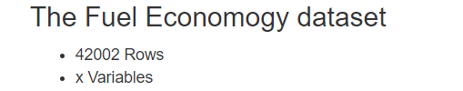
DATASET

Slide 3
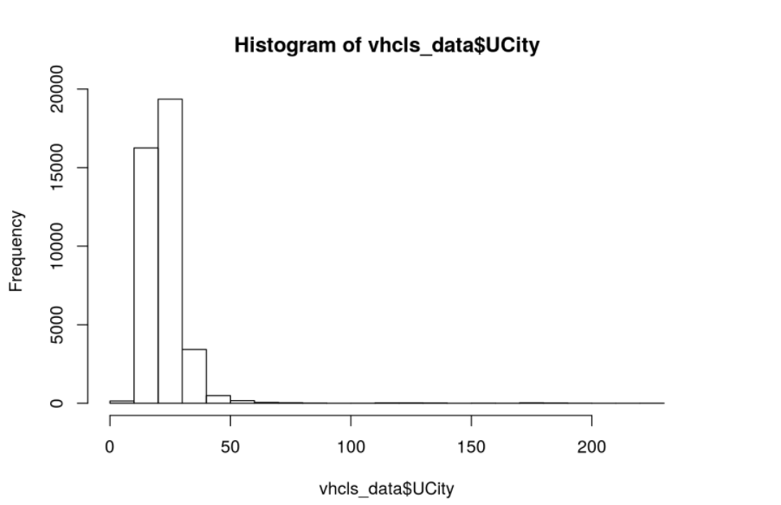
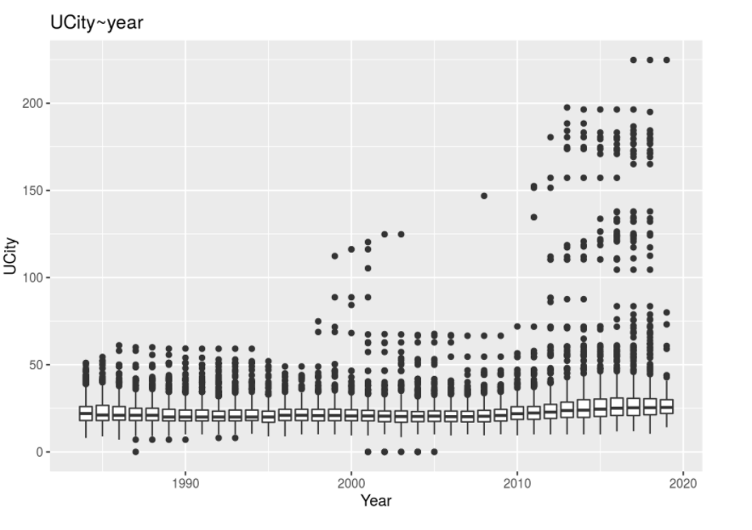
EDA

Slide 4
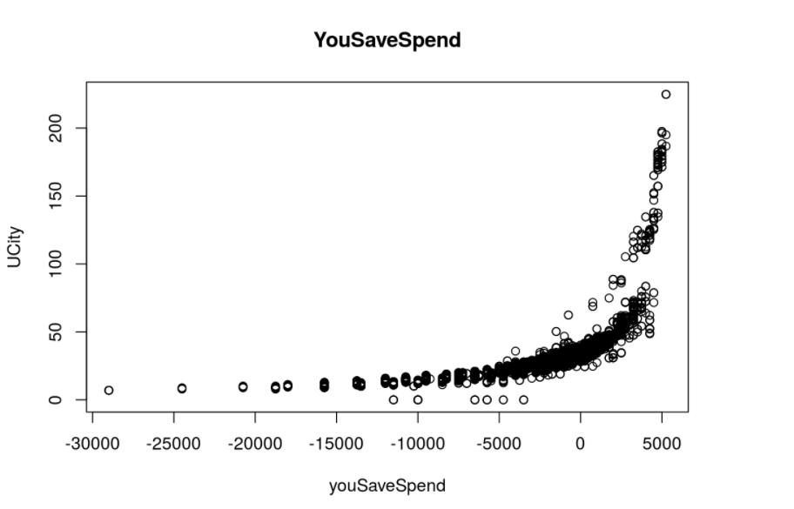
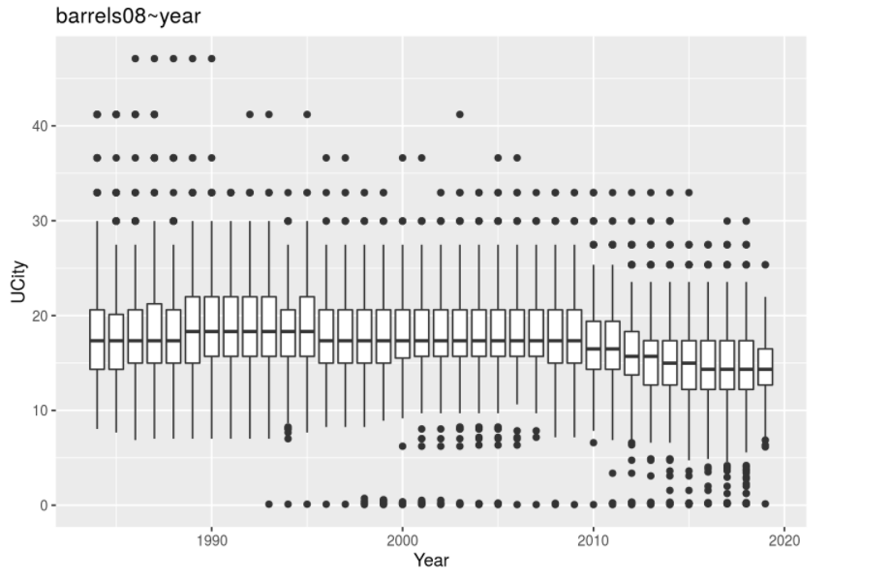
EDA

Slide 5
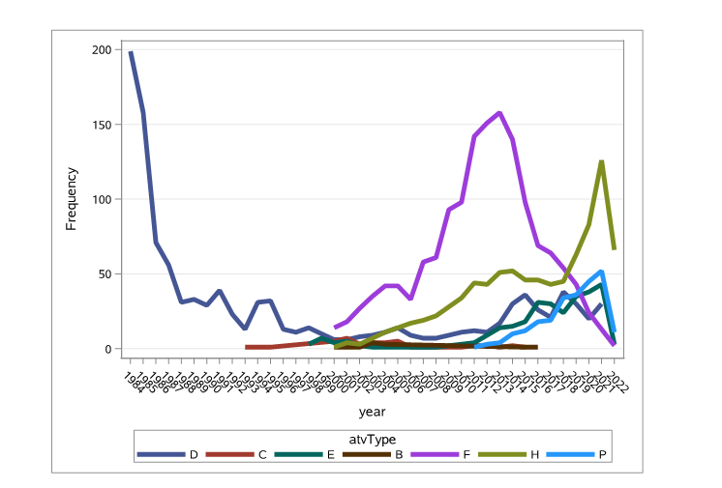
EDA

Slide 6
Data Insights
The dataset has two contrast cases of vehicles. (39829 non EV) and EV.
Premium and Regular fuelType vehicle are top co2 emitters.
Most common transmission type is Automatic 4 and 4 Speed
The median annual petroleum consumption (barrels08) is start to decrease post 2010.
cylinders are negatively correlated with UCity. (-0.8157), which indicates the bigger the vehicle the less the miles per gallon
Storngly correlated with UCity (0.6583)
There are 169 vehicles having UCity > 75. And as was expected, dominant majority (150+) are Electric vehicles.

Slide 7
DATA CLEANING
Filtering data for Electric and Non Electric Variables.
Removing the missing categorical value records.
Removing the records with 0 value of Ucity.
Converting categorical variable to Numeric/Binary for analysis.
Removing the hybrid records.
Filtering data for Electric and Non Electric Variables.
Removing the missing categorical value records.
Removing the records with 0 value of Ucity.
Converting categorical variable to Numeric/Binary for analysis.
Removing the hybrid records.

Slide 8
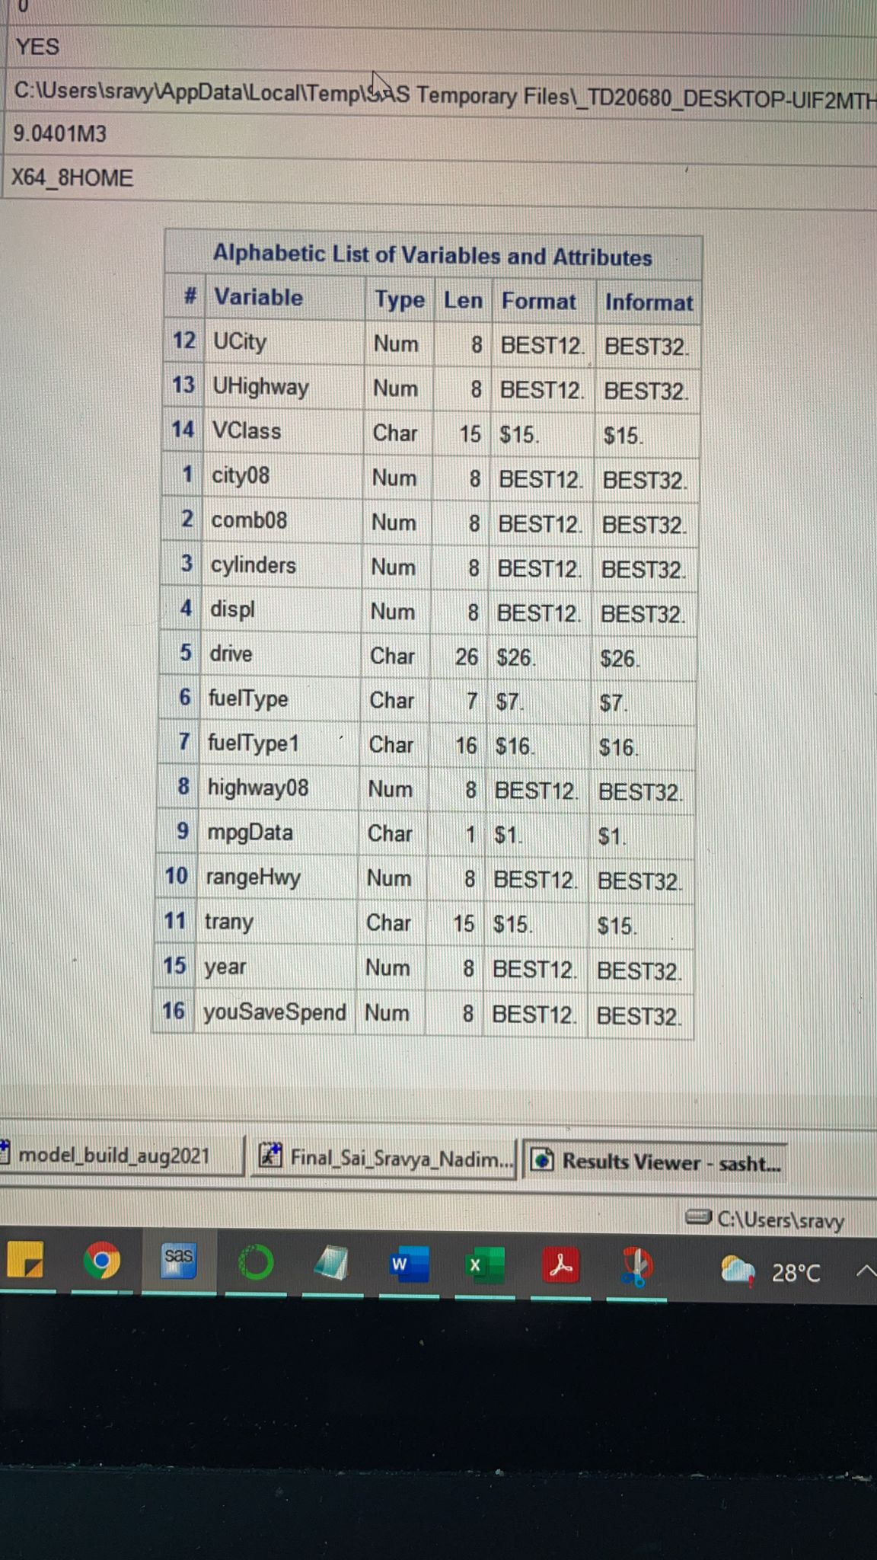
Modelling
Linear Regression: Regression models to predict Ucity using the following variables.

Slide 9
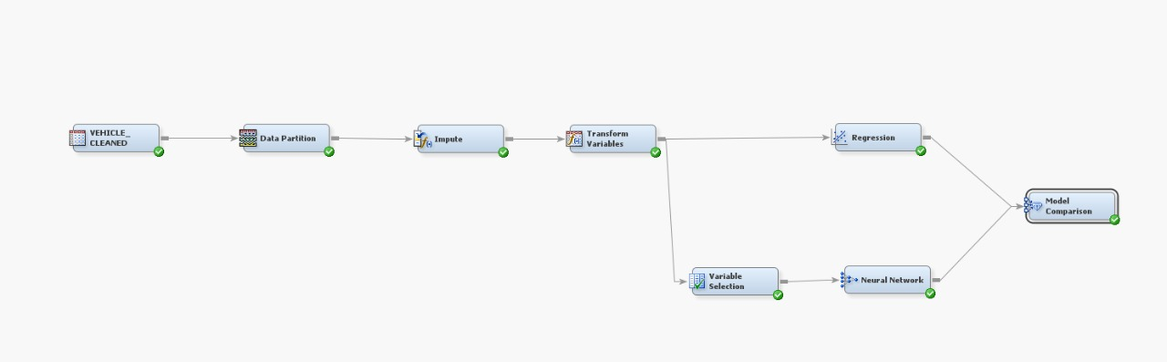
Predictive diagram

Slide 10
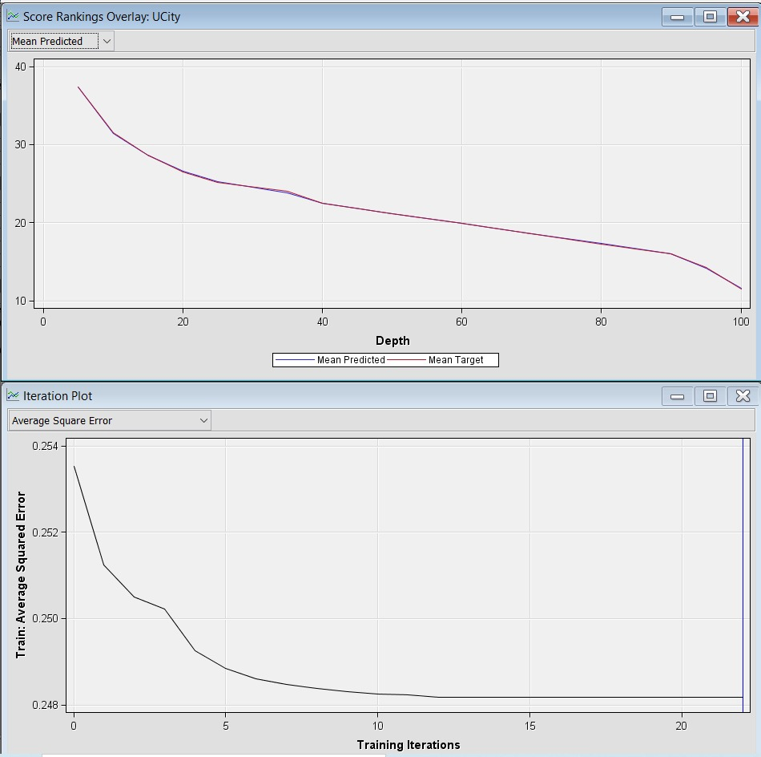
Neural Network
The Neural network has been done post the variable selection and the following results were obtained.

Slide 11
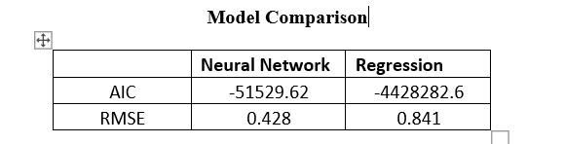
Model Comparison
Neural Network has a better Root mean squared values and the AIC hence, neural network has been chosen.

Slide 12
Thank You!

